Slide 1

GLOW AI
SKIN CARE RECOMMENDATION SYSTEM

Slide 2
TABLE OF CONTENT
Introduction
Dataset Description
Visualisation
Datacleaning
Models
Front end and back end
Conclusion
Future Work
Ingoude Company

Slide 3
INTRODUCTION
In today's fast-moving world of skincare, where there are so many options for products, it can feel overwhelming to find the right skincare routine that fits your needs and preferences. The many options and changing trends in skincare can make people feel confused and unsure about where to begin. Recommendation systems are helpful tools that give users recommendations based on what they like and need. They make things easier for users by suggesting things that they might like.

Slide 4
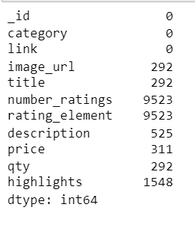
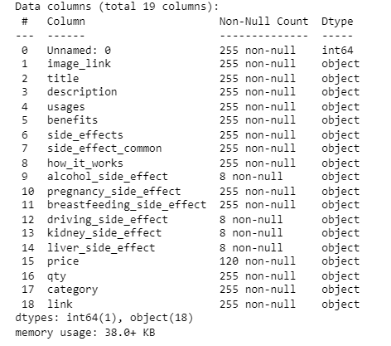
DATASET DETAILS
Where the data came from? We gathered information from the 1mg website using a tool called Selenium that helps extract data from websites.

Slide 5
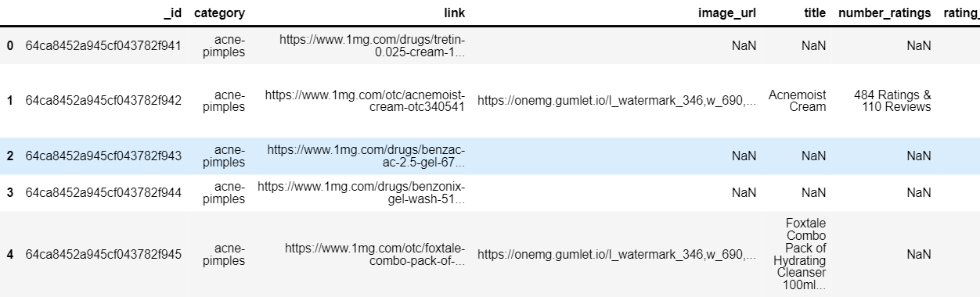
Ingoude Company

Slide 6
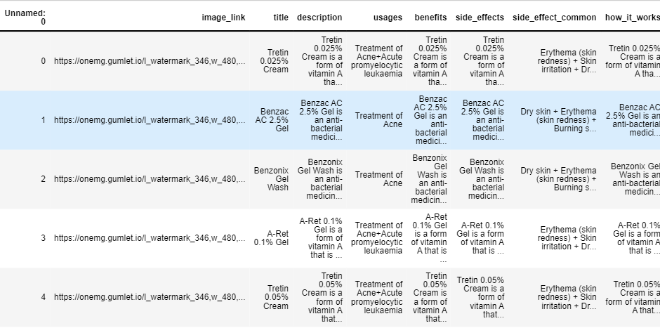
Ingoude Company

Slide 7
EDA AND VISUALISATION
Ingoude Company

Slide 8
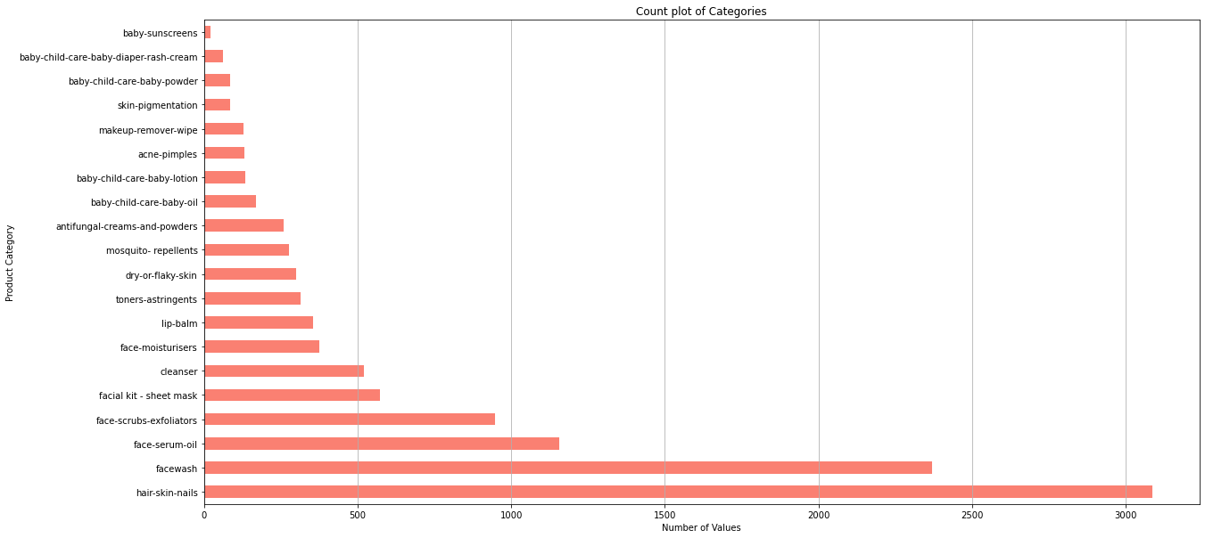
Count plot of categories:
Ingoude Company

Slide 9
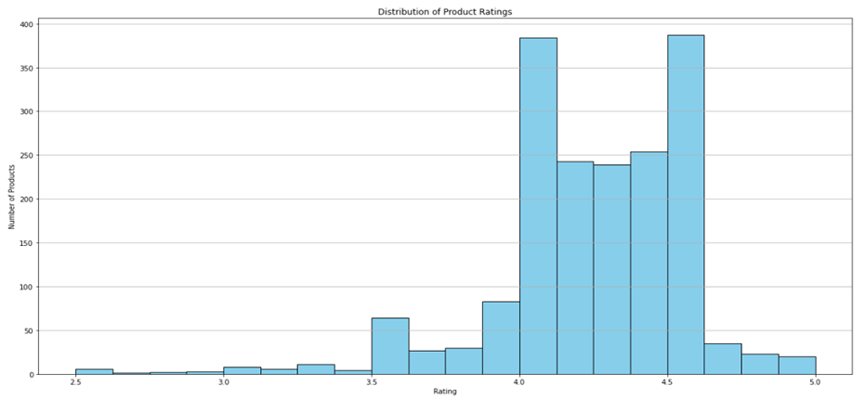
Distribution plot of Product Rating:
Ingoude Company

Slide 10
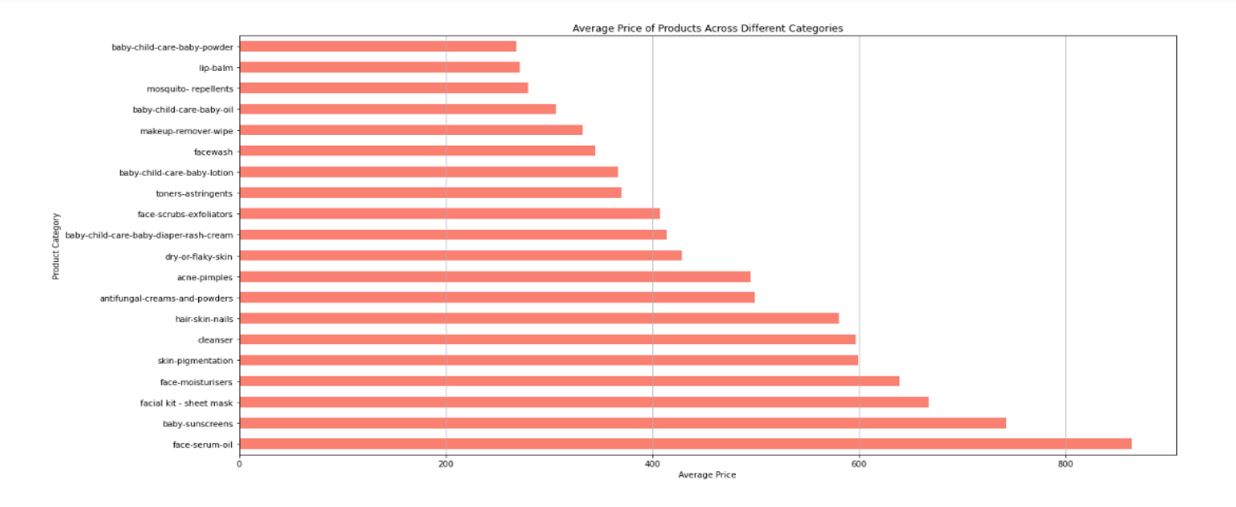
AVERAGE PRICE OF PRODUCTS ACROSS DIFFERENT CATEGORIES:

Slide 11
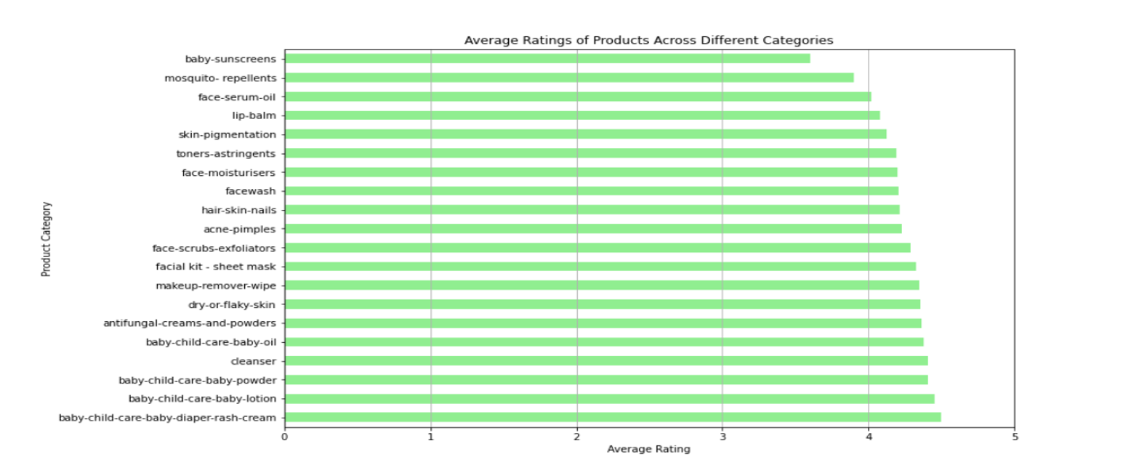
Average Ratings of product Across Different categories:

Slide 12
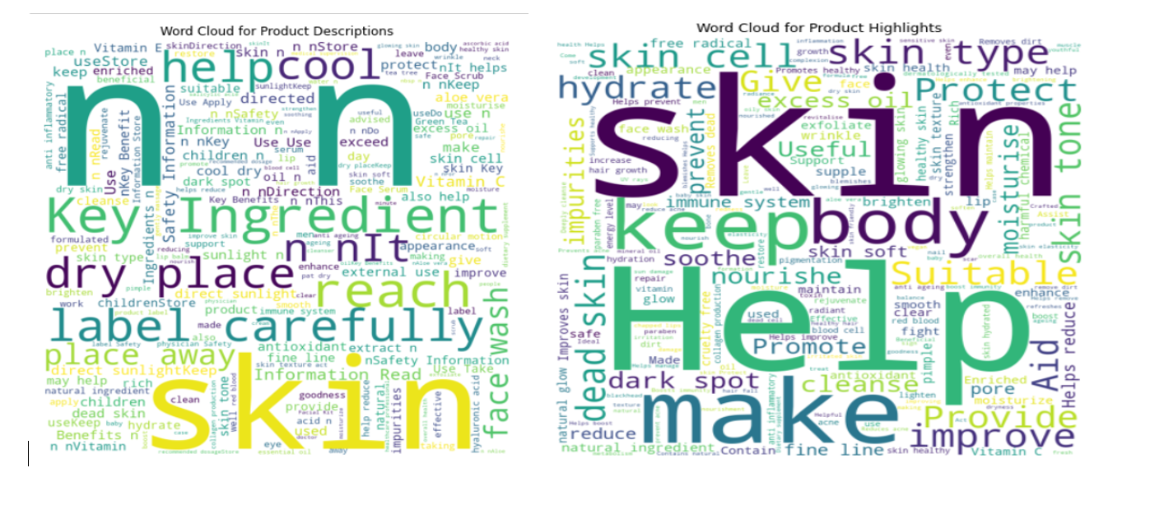
WORD CLOUD

Slide 13
DATA PREPROCESSING
Ingoude Company

Slide 14
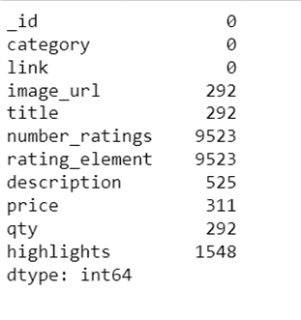
Missing Values:
Ingoude Company

Slide 15
Text preprocessing
1. Lowercasing: All content was changed over to lowercase to guarantee consistency and to treat words with distinctive capitalizations as the same. This disposes of the plausibility of copy representations of words based on capitalization.
2. Dealing with Extraordinary Characters: Extraordinary characters such as URLs and hashtags were supplanted with placeholders. URLs were supplanted with 'URL', and hashtags were supplanted with 'HASHTAG'. This step guarantees that these components are treated as unmistakable substances and don't meddled with ensuing investigation.
3. Expelling Accentuation: Accentuation marks were evacuated from the content. Usually done to streamline the content and avoid accentuation from being treated as partitioned tokens amid tokenization.

Slide 16
4. Tokenization: The content was tokenized into person words. Tokenization breaks down the content into its constituent words, making it less demanding to analyze and handle.
5. Removing Stopwords: Stopwords, which are commonly utilized words that ordinarily don't carry critical meaning (e.g., "and", "the", "is"), were evacuated from the content. This step decreases the dimensionality of the information and centers the examination on important substance words.
6. Lemmatization: The words were lemmatized, which includes lessening words to their base or root frame. This makes a difference in solidifying diverse shapes of the same word (e.g., "running" and "ran" both ended up "run"), supporting in more precise investigation.
Ingoude Company

Slide 17
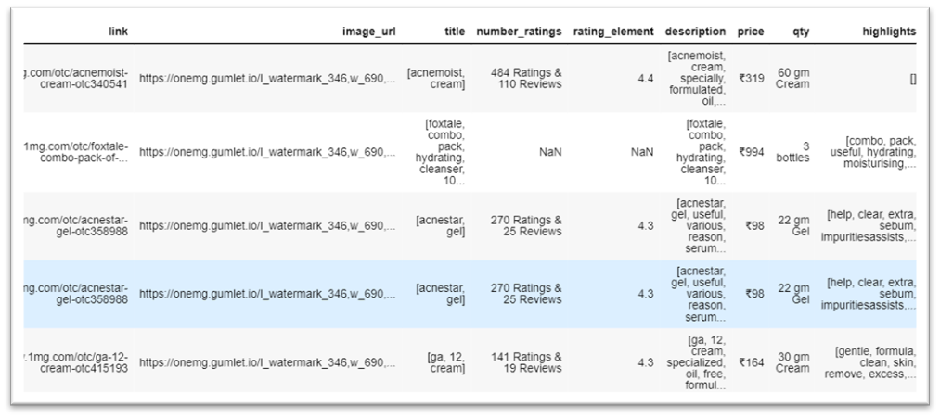

Slide 18
FEATURE ENGINEERING
Ingoude Company

Slide 19
TF-IDF Vectorization:
TF-IDF Vectorization is a method used to convert text into numerical vectors that can be understood by machine learning models. It is commonly used in natural language processing tasks. On the other hand, User Input Representation refers to how user inputs or queries are transformed into a format that can be processed by a system.
The most important part of our recommendation system is based on the idea of TF-IDF vectorization. Term Frequency-Inverse Document Frequency (TF-IDF) is a way to measure how important words are in a document compared to all the documents combined. This process turns text data into numbers so that it can be easily studied and analyzed.
Before analyzing the data, the TF-IDF vectorizer was used on the dataset's collection of text. Each item was now shown as a direction in a space with many dimensions. Each dimension matches a different word and its importance in that item.

Slide 20
MODELLING
Ingoude Company

Slide 21
We have done cosine similarity and Euclidian distance.
Cosine similarity became the preferred way to measure how similar user vectors and product vectors are to each other. This calculation measures how closely two vectors line up with each other in a high-dimensional space. The similarity scores show how similar the user's input is to each product.
The process of recommending products involves arranging them in a list based on how similar they are, with the most similar products appearing at the top of the list. Higher scores mean that the text is more closely related to what the user asked for. The products that are most similar are chosen as recommendations.
The content-based suggestion system is really good at giving personalized suggestions for products by looking at the words in the content. This system helps users find things they like by using technology that understands and learns from human language and choices
Ingoude Company

Slide 22
Evaluation Metrics:
Precision at K is an important measure that tells us how good the recommendations are in a system that suggests things to us. This measurement evaluates how many of the top ‘5' recommended items are actually useful for the user
Recall measures how many recommendations are included, complementing the Precision metric. While Precision at K assesses the accuracy of the top ‘5' recommendations, Recall at K determines the proportion of all relevant items included in those top ‘5' suggestions.

Slide 23
FRONT END AND BACK END
Ingoude Company

Slide 24
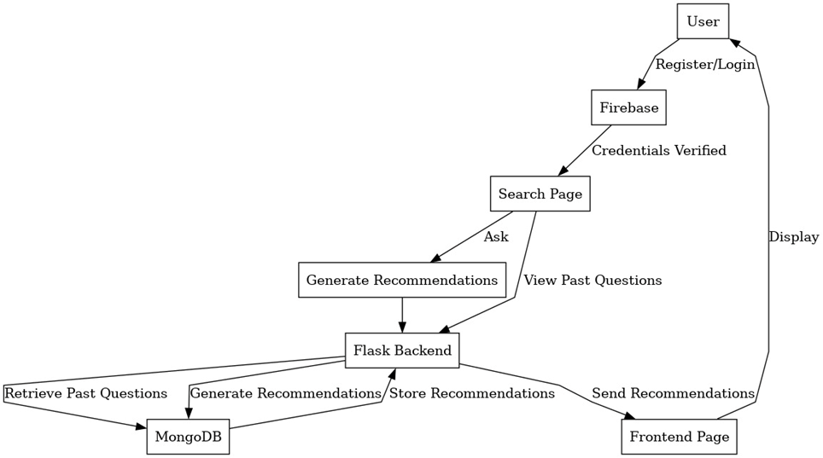

Slide 25
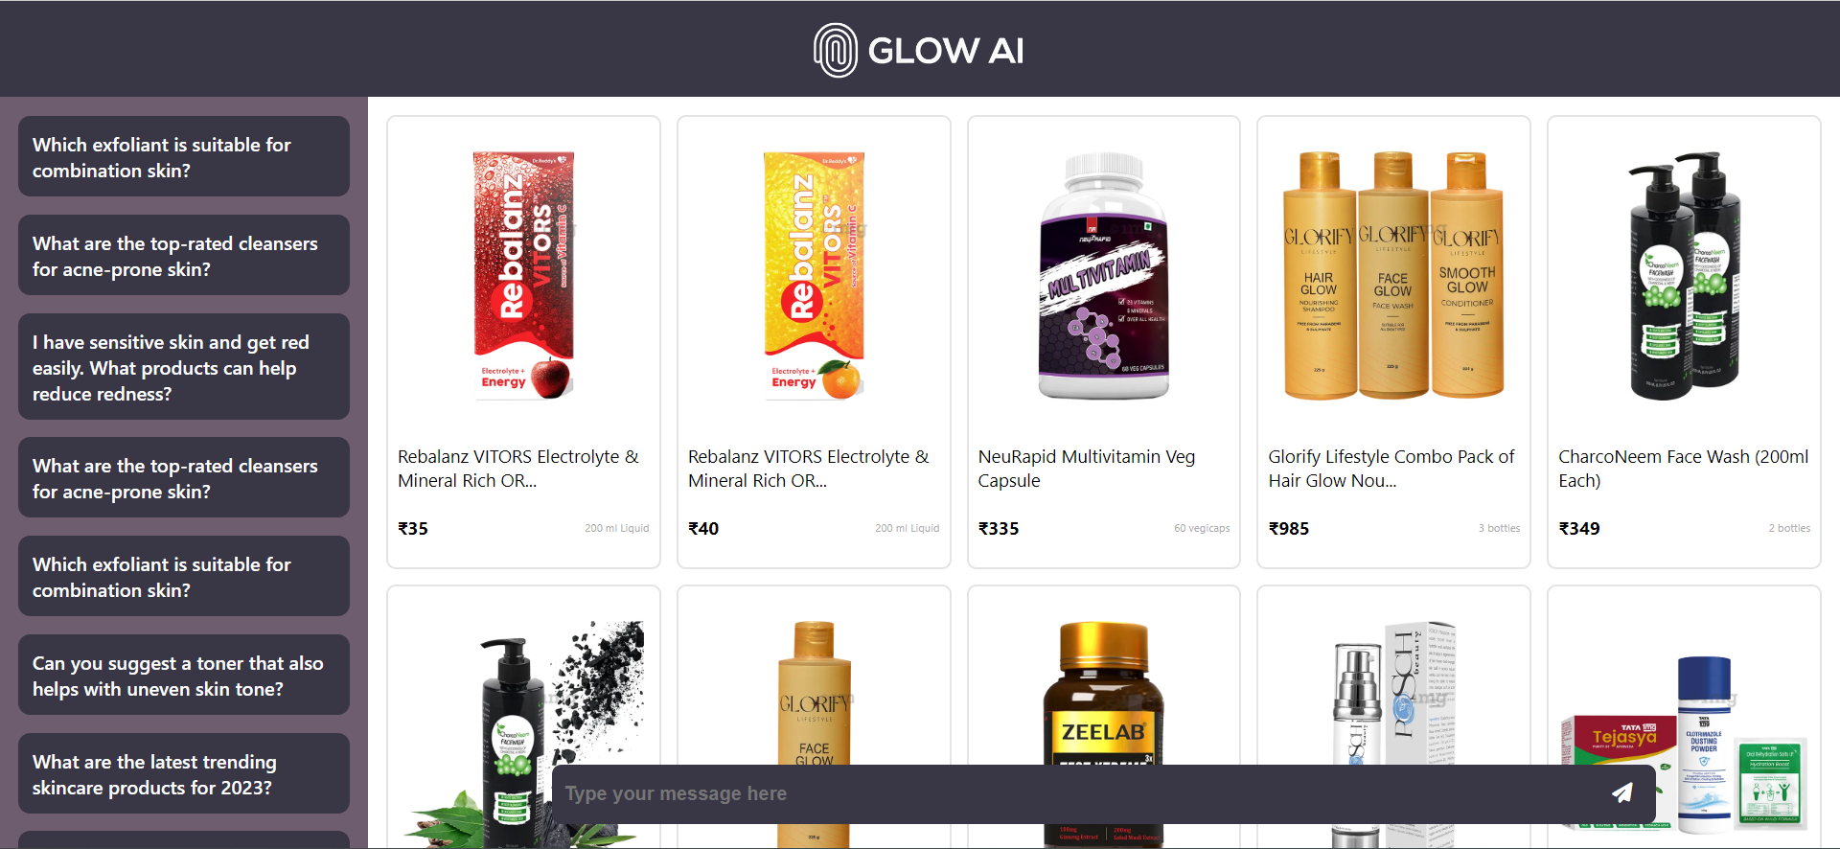

Slide 26
Conclusion
We have made it easier to choose skincare products by creating a system that suggests the best ones for your skin. By using data analysis, we can give users personalized product suggestions. The system combines smart technology with an easy-to-use screen to help people make better choices when it comes to their skincare routine. To sum up, the content-based recommendation system shows the power of analyzing text and machine learning in making personalized user experiences. This means that it can understand written patterns and give helpful suggestions, which helps people make better decisions and be more involved

Slide 27
Future Work:
In the future, we plan to keep making our skin care recommendation system better and bigger. We want to add a feature that suggests skincare products based on pictures. This feature would use the appearance of the skincare items to make recommendations. In addition, our goal is to improve and strengthen our recommendation system by trying out more advanced methods and algorithms. We want our system to be a very helpful tool for people who want the best skincare options.

Slide 28
References:
Towards Data Science. (n.d.). Text Preprocessing in Natural Language Processing using Python. https://towardsdatascience.com/text-preprocessing-in-natural-language-processing-using-python-6113ff5decd8
Title: Bi, Tri, and N-grams with Python
URL: https://levelup.gitconnected.com/bi-tri-and-n-grams-with-python-a9717264e6f2

Slide 29
Thank you!

